Slide 1
ARM Memory Map and Memory Access
The ARM CPU uses 32-bit addresses which gives us a maximum of 4 GB (gigabytes) of memory space. This 4GB of memory space has addresses 0x00000000 to 0xFFFFFFFF, meaning each byte is assigned a unique address (ARM is a byte-addressable CPU).

Slide 2
The 4GB of memory space is divided into three regions: code, data, and peripheral devices.
PPB – Private Peripheral Bus
Sample Memory Space Allocation in ARM Cortex

Slide 3
ARM uses the memory mapped I/O.
There is no standard for exact locations and types of memory and peripherals. Therefore the licensees can implement the memory and peripherals as they choose. For this reason the amount and the address locations of memory used by Flash ROM, SRAM, and I/O peripherals varies among the family members and chip manufacturers.
Some of the memory addresses are set aside for the external (off-chip) memory and peripherals.

Slide 4
Example:
A given ARM chip has the following address assignments. Calculate the space and the amount of memory given to each section.
(a) Address range of 0x00100000 – 0x00100FFF for EEPROM
(b) Address range of 0x40000000 – 0x40007FFF for SRAM
(c) Address range of 0x00000000 – 0x0007FFFF for Flash
(d) Address range of 0xFFFC0000 – 0xFFFFFFFF for peripherals
(a) 0xFFF = 4K bytes.
(b) 7FFF = 32K bytes.
(c) 7FFFF = 512K bytes.
(d) 3FFFF = 256K bytes.

Slide 6
ARM buses and memory access
Memory Connection Block Diagram in ARM

Slide 7
D31–D0 Data bus
The 32-bit data bus of the ARM provides the 32-bit data path to the on-chip and offchip memory and peripherals. They are grouped into 8-bit data chunks, D0–D7, D8–D15, D16–D23, and D24–D31.
A31–A0
These signals provide the 32-bit address path to the on-chip and off-chip memory and peripherals. Since the ARM supports data access of byte (8 bits), half word (16 bits), and word (32 bits), the buses must be able to access any of the 4 banks of memory connected to the 32-bit data bus. The A0 and A1 are used to select one of the 4 bytes of the D31-D0 data bus.

Slide 8
Memory Block Diagram in ARM

Slide 9
AHB and APB buses
The ARM CPU is connected to the on-chip memory via an AHB (advanced high performance bus). The AHB is used not only for connection to on-chip ROM and RAM, it is also used for connection to some of the high speed I/Os (input/output) such as GPIO (general purpose I/O). ARM chip also has the APB (advanced peripherals bus) bus dedicated for communication with the on-chip peripherals such as timers, ADC, serial COM, SPI, I2C, and other peripheral ports. While we need the 32-bit data bus between CPU and the memory (RAM and ROM), many slower peripherals are 8 or 16 bits and there is no need for entire fast 32-bit data bus pathway. For this reason, ARM uses the AHB-to-APB bridge to access the slower on-chip devices such as peripherals.

Slide 10
AHB and APB in ARM

Slide 11
Bus cycle time
To access a device such as memory or I/O, the CPU provides a fixed amount of time called a bus cycle time. The bus cycle time used for accessing memory is often referred to as MC (memory cycle) time. The time from when the CPU provides the addresses at its address pins to when the data is expected at its data pins is called memory read cycle time.
While for on-chip memory the cycle time can be 1 clock, in the off-chip memory the cycle time is often 2 clocks.

Slide 12
Code memory region
The 4 GB of ARM memory space is organized as 1G × 32 bits since the ARM instructions are 32-bit. The internal data bus of the ARM is 32-bit, allowing the transfer of one instruction into the CPU every clock cycle. The fetching of an instruction in every clock cycle can work only if the code is word aligned, meaning each instruction is placed at an address location ending with 0, 4, 8, or C.

Slide 13
SRAM memory region
A section of the memory space is used by SRAM. The SRAM can be on-chip or offchip (external). This on-chip SRAM is used by the CPU to store parameters. It is also used by the CPU for the purpose of the stack.
Data misalignment in SRAM
If the data is aligned, for every memory read cycle, the ARM brings in 4 bytes of information (data or code) using the D31–D0 data bus.
The single cycle access of memory is also used by ARM to bring into registers 4 bytes of data every clock cycle assuming that the data is aligned. To make sure that data are also aligned we use the align directive.

Slide 14
Accessing non-aligned data
LDR R1, [R0] R0=0x80000000
LDR R1, [R0] R0=0x80000001 8 bytes contents of memory locations 0x80000000 through 0x80000007 are being fetched in two consecutive
Cycles.
Memory Access for Aligned and Non-aligned Data

Slide 15
Using LDR instruction with DCD and ALIGN directives
The DCD and DCDU directives are used for 32-bit (word) data. The DCD directive ensures 32-bit data types are aligned, in contrast to DCDU which does not. DCD is used as follows:
VALUE1 DCD 0x99775533
This ensures that VALUE1, a word-sized operand, is located in a word aligned address location.
An instruction accessing it will take only a single memory cycle.
The one-time use of ALIGN directive at the beginning of data area using DCDU makes the data aligned for that group of data.

Slide 16
Using LDRH with DCW and ALIGN directives
With DCWU, we must use the ALIGN directive in the data area of a given program to ensure they are aligned. This is in contrast to the DCW directive which ensures data type to be half-word aligned.
This is especially the case when we use the LDRH instruction.
Example:
LDR R1,=0x80000000 ;R1=0x80000000
LDR R3,=0xF31E4598 ;R3=0xF31E4598
LDR R4,=0x1A2B3D4F ;R4=0x1A2B3D4F
STR R3,[R1]
STR R4,[R1,#4]
LDRH R2, [R1]
LDRH R2, [R1,#1]
LDRH R2, [R1,#2]
LDRH R2, [R1,#3]

Slide 17
LDRH R2, [R1]
LDRH R2, [R1,#1]
LDRH R2, [R1,#2] instructions take only one memory cycle.
But LDRH R2, [R1,#3] will take two memory cycles to load the data

Slide 18
Using LDRB with DCB and ALIGN directives
The problem of misaligned data does not exist when the data size is bytes. In cases such as using the string of ASCII characters with the DCB directive, accessing a byte takes the same amount of time (one memory cycle) as an aligned word (4 bytes), regardless of the address location of the data.
Peripheral region
A section of memory is set aside for peripherals. The type of peripherals and memory address locations used is unique to a vendor. The ARM manufacturers provide the details of memory map for the peripherals.

Slide 19
Harvard Architecture and ARM
In recent years many ARM manufacturers are using the Harvard architecture for ARM CPUs.
Old ARM architectures up to ARM7 use Von Neumann architecture.
The Harvard architecture feeds the CPU with both code and data at the same time via two sets of buses, one for code and one for data. This increases the processing power of the CPU since it can bring in more information.

Slide 20
Von Neumann vs. Harvard Architecture

Slide 21
ARM Bit-Addressable Memory Region
One of the most important features of the CPU is the ability to access the RAM and I/O ports in bits instead of bytes. This is a very important and powerful feature of the ARM used widely in the embedded system design and applications.
Bit-addressable (bit-band) SRAM
Of the 4GB memory space of the ARM, a number of bytes are bit-addressable. The ARM literature refers to this region as the bit-band region. Since the ARM instruction is 32-bit and the CPU executes code one instruction at a time, the code (Flash ROM) space is always word size and word aligned,

Slide 22
The bit addressable RAM and I/O locations vary among the family members and vendors.
The ARM generic manual defines the location addresses of bit-band as 0x20000000 to 0x200FFFFF for SRAM and 0x40000000 to 0x400FFFFF for peripherals.
The bit-band (bit-addressable) regions are the only region that can be accessed in both bit and byte/halfword/word formats while the other area of memory must be accessed in byte/halfword/word size.
For the ARM Cortex-M, the bit-band SRAM addresses 0x20000000 to 0x200FFFFF (1M bytes) is given alias addresses of 0x22000000 to 0x23FFFFFF.
The bit addresses 0x22000000 to 0x2200001F are for the first byte of SRAM location 0x20000000, and 0x22000020 to 0x2200003F are the bit addresses of the second byte of SRAM location 0x20000001, and so on.

Slide 23
SRAM bit-addressable region and their alias addresses

Slide 24
Since each byte of SRAM has 8 bits we need an address for each bit.
This means we need at least 8M address locations to access 8M bits, one address for each bit.
To make the addresses word-aligned the ARM provides 4-byte alias address for each bit.
For example, 0x22000000 to 0x2200001F is assigned to a single byte location of 0x20000000.
That means we have 0x22000000 to 0x23FFFFFF (total of 32M locations, as alias addresses) for 1M bytes of address.
SRAM locations 0x20000000 – 0x200FFFFF are both byte-addressable and bit-addressable. The only difference is when we access it in byte (or halfword or word) we use addresses 0x20000000 to 0x200FFFFF, but when they are accessed in bit, they are accessed via their alias addresses of 0x22000000 to 0x23FFFFFF.

Slide 25
Example:
Write a program to set HIGH the D6 of the SRAM location 0x20000001 using a) byte address and b) the bit alias address.
Solution:
a) LDR R1,=0x20000001 ;load the address of the byte
LDRB R2,[R1] ;get the byte
ORR R2,R2,#2_01000000 ;make D6 bit high
STRB R2,[R1] ;write it back
b) address 0x22000038 is the bit address of D6 of SRAM location 0x20000001.
LDR R1,=0x22000038 ;load the alias address of the bit
MOV R2,#1 ;R2 = 1
STRB R2,[R1] ;Write one to D6

Slide 26
Peripheral I/O port bit-addressable region
The general purpose I/O (GPIO) and peripherals such as ADC, DAC, RTC, and serial COM port are widely used in the embedded system design.
ARM has set aside 1M bytes of address space to be used bit-band (bit-addressable) I/O and peripherals.
The address space assigned to bit-band peripherals and GPIO is 0x40000000 to 0x400FFFFF with address aliases of 0x42000000 to 0x43FFFFFF.

Slide 27
Stack and Stack Usage in ARM
Nested calls in ARM:
Upon calling a subroutine from the main program using the BL instruction, R14, the linker register, keeps track of where the CPU should return after completing the subroutine. Now, if we have another call inside the subroutine using the BL instruction, then it is our job to store the original R14 on the stack. Failure to do that will end up crashing the program.
The stack is a section of RAM used by the CPU to store information temporarily.
This information could be data or an address or CPU registers when calling a subroutine.
Stack is also widely used when executing an interrupt service routine (ISR).

Slide 28
How stacks are accessed
If the stack is a section of RAM, there must be a register inside the CPU to point to it. In the ARM CPU the register used to access the stack is R13.
The storing of CPU information such as the registers on the stack is called a PUSH, and loading the contents of the stack back into a CPU register is called a POP. In other words, a register is pushed onto the stack to save it and popped off the stack to retrieve it.

Slide 29
Pushing onto the stack
The stack pointer (SP) points to the top of the stack (TOS).
As we push (store) data onto the stack, the data are saved in RAM (where the SP points to) and SP must be decremented (or incremented) to point to the next location.
In the ARM we have a choice of either incrementing the SP or decrementing it. We must actually code the instruction for stack pointer decrementation (or incrementation)
To push a register onto stack we use the STR and SUB instructions

Slide 30
STR Rr, [R13] ;Rr can be any registers (R0-R12)
SUB R13, R13, #4 ;decrement stack pointer
For example, to store the value of R1 we can write the following instructions:
STR R1, [R13] ;store R1 onto the stack,
SUB R13, R13, #4 ;decrement SP

Slide 31
Popping from the stack
Popping (loading) the contents of the stack back into a given register is the opposite process of pushing. When the POP is executed, the SP is incremented (or decremented) and the top location of the stack is copied (loaded) back to the register.
The stack is LIFO (Last-In-First-Out) memory.
To pop into a register from the stack we use the LDR and ADD instructions

Slide 32
To retrieve data from stack we can use the LDR instruction.
ADD R13, R13, #4 ;increment stack pointer
LDR Rr, [R13] ;Rr can any of the registers (R0-R12)
For example, the following instructions pop from the top of stack and copy to R1:
ADD R13, R13, #4 ;increment SP
LDR R1, [R13] ;load (POP) the top of stack to R1

Slide 33
Using LDM and STM instructions for the stack
Another way to push register contents onto the stack is to use STM (store multiple) and LDM (load multiple) instructions.
STM
STM R11, {R0-R3}
;Store R0 through R3 onto memory pointed to by R11
STM R7, {R0,R3,R5}
;Store R0, R3, R5 onto memory pointed to by R7

Slide 34
LDM
LDM R11, {R0-R3}
;Load R0 through R3 from memory pointed to by R11
LDM R7, {R0,R3,R5}
;Load R0,R3,R5 from memory pointed to by R7

Slide 35
Writeback options of STM and LDM
We can specify the action to be taken for the pointer. The action
can be increment or decrement before or after the push or pop is done.
Option Description
IA Increment After
IA stands for Increment After and adds four to the pointer after load or storing each register.
IB Increment Before
IB stands for Increment Before and adds four to the pointer before load or storing each register.

Slide 36
DA Decrement After
DA stands for Decrement After and subtracts four from the pointer after load or storing each register.
DB Decrement Before
DB stands for Decrement Before and subtracts four from the pointer before load or storing each register.

Slide 37
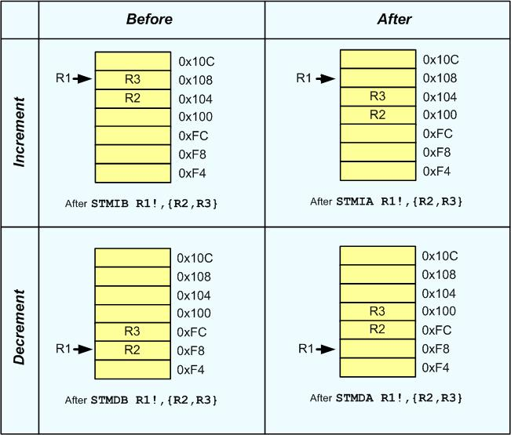
For further clarification assume that R1 = 0x100. Figure below shows the memory after
running STM R1!,{R2,R3} with each of IA, IB, DA and DB options.

Slide 38
We have four stack structure, either it is ascending or descending. The stack is called ascending when it is incremented after each store (PUSH) instruction and decremented after each load (POP) instruction.
It is called descending when it is decremented after each store (PUSH) instruction and incremented after each load (POP) instruction.
The stack pointer can point to the last filled location; in this case the stack is called Full Stack.
The stack pointer can point to the next available location, as well; which is called an Empty Stack.
To support 4 types of the stack STM and LDM instructions take four suffixes IA, IB, DA and DB.
If no suffix is used, the default action is IA

Slide 39
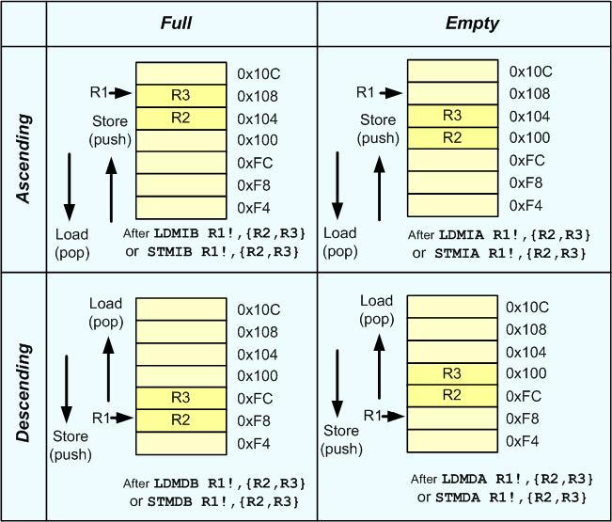

Slide 40
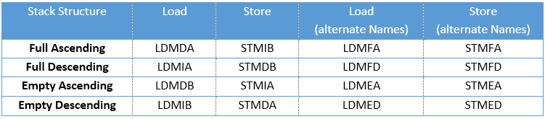
The four stack structures and the options of LDM and STM instructions
The stack structure used by ARM for PUSH, POP instructions and interrupt handling is a Full Descending stack using R13 as the stack pointer. To support Full Descending stack, STMDB and LDMIA pair of instructions should be used.

Slide 41
STMDB Store Multiple register and Decrement Before
Flags: Unaffected.
Format: STMDB Rn,{Rx,Ry,…}
Function: Stores registers Rx, Ry,… into consecutive memory locations. The starting address of memory location is given by Rn register. The source registers are separated by comma and placed in braces.
STMDB R11!, {R0, R1, R2, R3}
STMDB R11!, {R0-R3}
;Store R0 through R3 onto memory pointed to by R11 and update R11 with the final address
STMDB R11!, {R0, R5, R3}
;Store R0, R3 and R5 onto memory pointed to by R11 and update R11 with the final address

Slide 42
STMDB R11!, {R0-R3, R8, R7}
;Store R0 through R3, R7 and R8 onto memory pointed to by R11 and update R11 with the final address
LDMIA Load Multiple registers and Increment after each Access
Flags: Unaffected.
Format: LDMIA Rn, {Rx,Ry,..}
Function: This is the same as the LDM instructions. This IA (Increment the address after each Access) is the default. We use this for Poping (loading) multiple words from descending stack into CPU registers.
LDMIA R11!, {R0, R1, R2, R3}
LDMIA R11!, {R0-R3}
LDMIA R11!, {R0, R5, R3}

Slide 43
When the registers are pushed on to the stack, lower numbered registers are stored in the lower address and when popped, data from lower address goes into the lower numbered register.

Slide 44
PUSH and POP instructions.
PUSH PUSH register onto stack
Flags: Unaffected.
Format: PUSH {reg_list} ;PUSH reg_list onto stack
Function: Copies the contents of registers stated in reg_list onto the stack and decrements SP by 4, 8, 12, 16, … depending on the number of registers in reg_list.
Example:
PUSH {R1} ;PUSH the R1 onto top of stack
PUSH {R1,R4,R7} ;PUSH R1,R4,R7 onto top of stack
PUSH {R2-R6} ;PUSH the R2,R3,R4,R5,R6 onto top of stack
PUSH {R0,R5} ;PUSH the R0 and R5 onto top of stack
PUSH {R0-R7} ;PUSH the R0 through R7 onto top of stack
The PUSH instruction is alias for STMDB R13!.

Slide 45
POP POP register from Stack
Flags: Unaffected.
Format: POP {reg_list} ;reg_reg = words off top of stack
Function: Copies the words pointed to by the stack pointer to the registers indicated by the reg_list and increments the SP by 4, 8, 12, 16, … depending on the number of registers in the reg_list.
Example:
POP {R1} ;POP the top word of stack to R1
POP {R1,R4,R7} ;POP the top 3 words of stack to R1,R4,R7
POP {R2-R6} ;POP the top 5 words of stack to R2-R6
POP {R0,R5} ;POP the top 2 words of stack to R0 and R5
POP {R0-R7} ;POP the top 8 words of stack to R0-R7
The POP instruction is alias for LDMIA R13!.

